Slide 1

DEPARTMENT OF COMPUTER ENGINEERING, MODELING, ELECTRONICS AND SYSTEM ENGINEERING LM-Telecommunication Engineering: Smart Sensing, Computing and Networking IoT Security Project Title: IoT Sensor Data Monitoring System Supervisor : Dr. Antonio Guerrieri
Implemented by:
Rami Saleh Hussein Mohammed

Slide 2
Introduction
Overview of the project:
This project demonstrates an IoT-based sensor data monitoring system that:
Collects data from MQ2 (gas sensor) and DHT11 (temperature & humidity sensor) using an ESP32 microcontroller.
Sends the data to a Flask server for processing and storage.
verifies data integrity and authenticity using HMAC-SHA256.
ensures system availability against DOS attack.
Stores data in a MySQL database.
Publishes real-time data to HiveMQ Cloud (MQTT broker).
Display data values in Node-Red dashboard.

Slide 3
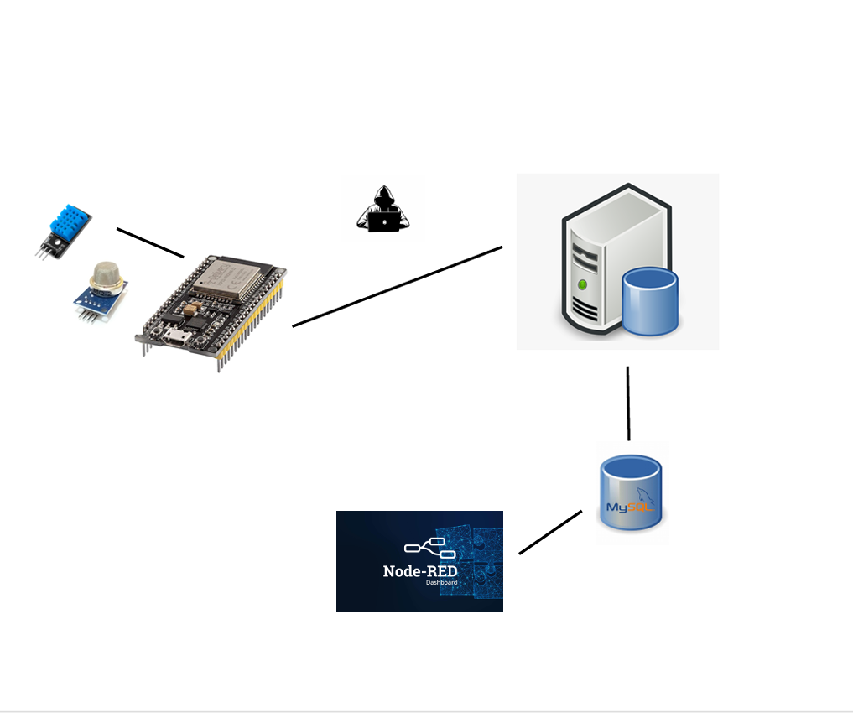
System Architecture
DHT11 & MQ-2 Sensors
Data Spoofing
UBUNTU Server
DOS
ESP32
DATA Base

Slide 4
System Architecture
Data Collection Layer: ESP32 + Sensors
Processing Layer: Flask server with security measures
Storage Layer: MySQL database
Visualization Layer: Node-RED dashboard, which provide Real-time Monitoring Features

Slide 5
Data flow in Normal scenario
ESP32 collects sensor readings
Transmitted via HTTP to Flask server
Server receives the data and store it in MySQL database
Data forwarded to Node-Red via MQTT Protocol
Real-time visualization on Node-Red dashboard

Slide 6
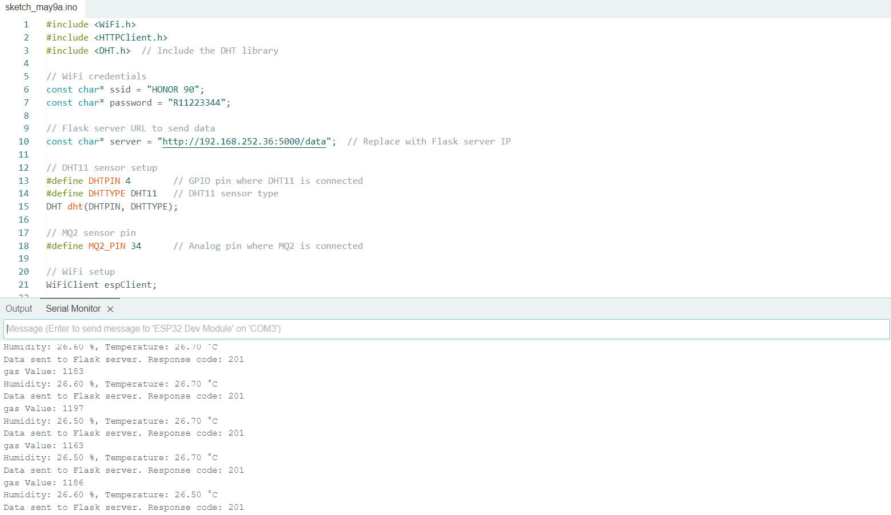
Data flow in Normal scenario
ESP32 sends data to the Server

Slide 7
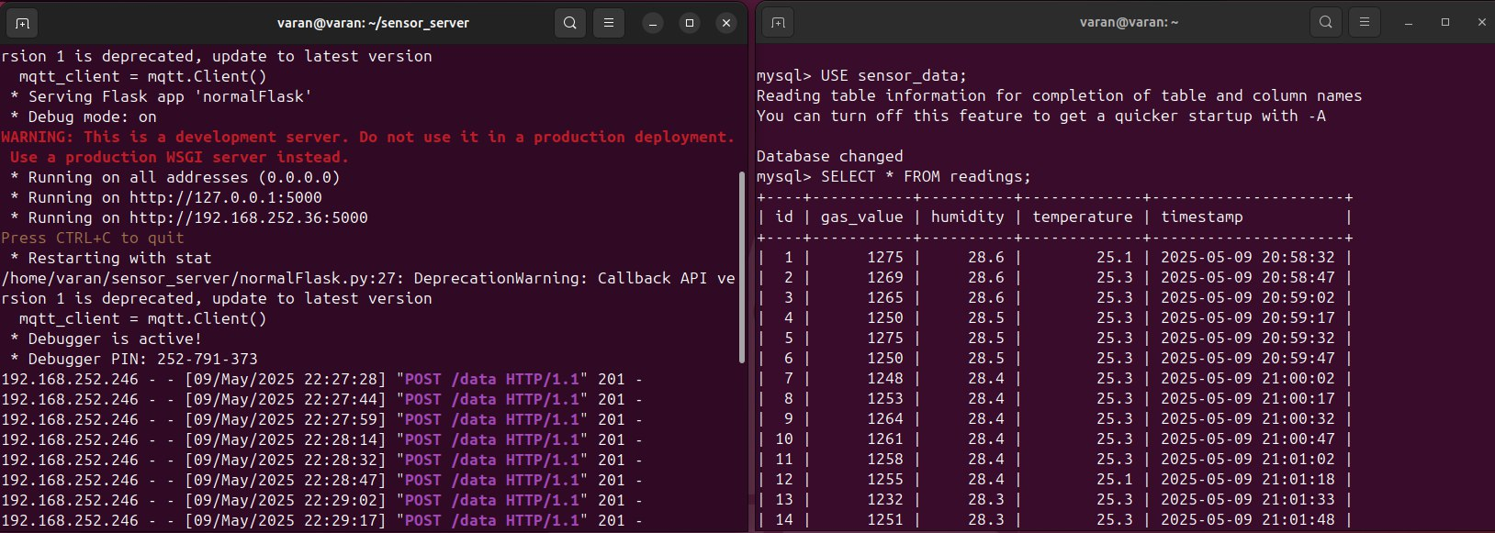
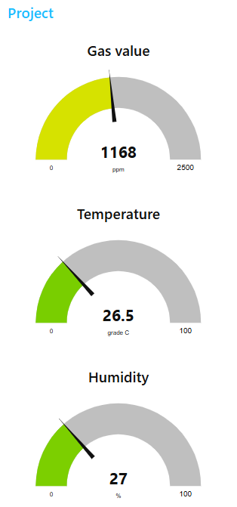
Data flow in Normal scenario
The Flask server after receiving the data from the ESP32 stores it in data base and sends it to the Nod-Red via MQTT protocol.

Slide 8
attack & defense - scenarios
There are two scenarios :
1 – simulate a DOS attack on the server & implement a defense mechanism.
2 – simulate a Data Spoofing & implement a defense mechanism.

Slide 9
attack & defense – scenario 1
Scenario 1 : simulate a DOS attack on the server & implement a defense mechanism.
DOS attack : floods a Flask server with excessive traffic , overwhelming its resources and making it unavailable to legitimate users (which is ESP32 in this case).
and this causing :
Server crashes (HTTP timeouts).
Database overload (MySQL slowdowns).
Blocked legitimate sensors data.

Slide 10
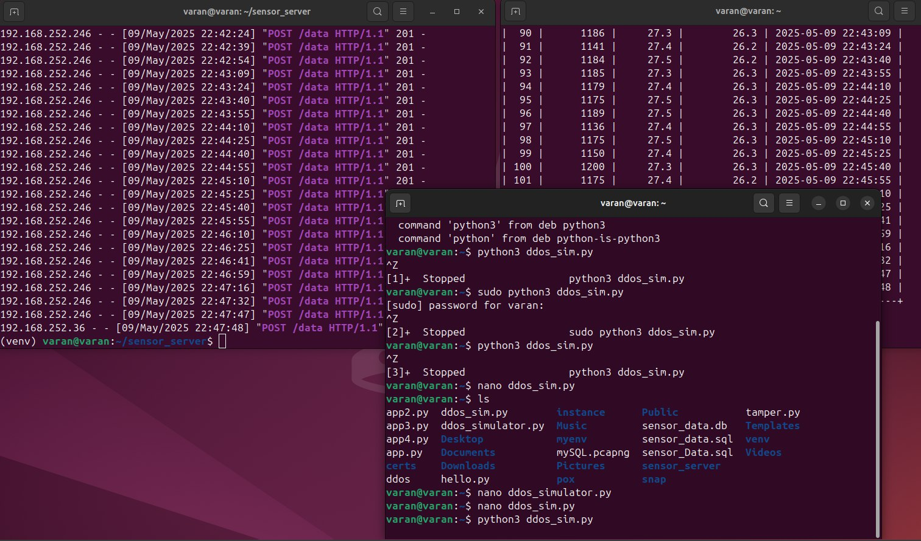
attack & defense – scenario 1
Implement the attack

Slide 11
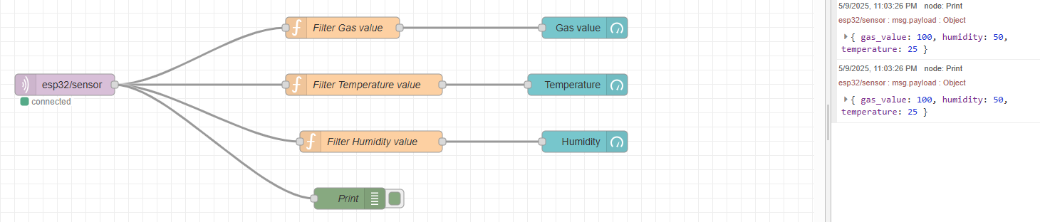
attack & defense – scenario 1
The values which sent from the server during the beginning of the DOS attack

Slide 12
attack & defense – scenario 1
There are two available options :
Rate Limiting:
Limits requests per IP address(e.g. 10 requests/minute)
Prevents server resource exhaustion
Firewall Rules (iptables/ UFW):
Blocks suspicious IP addresses
Filters malicious traffic patterns

Slide 13
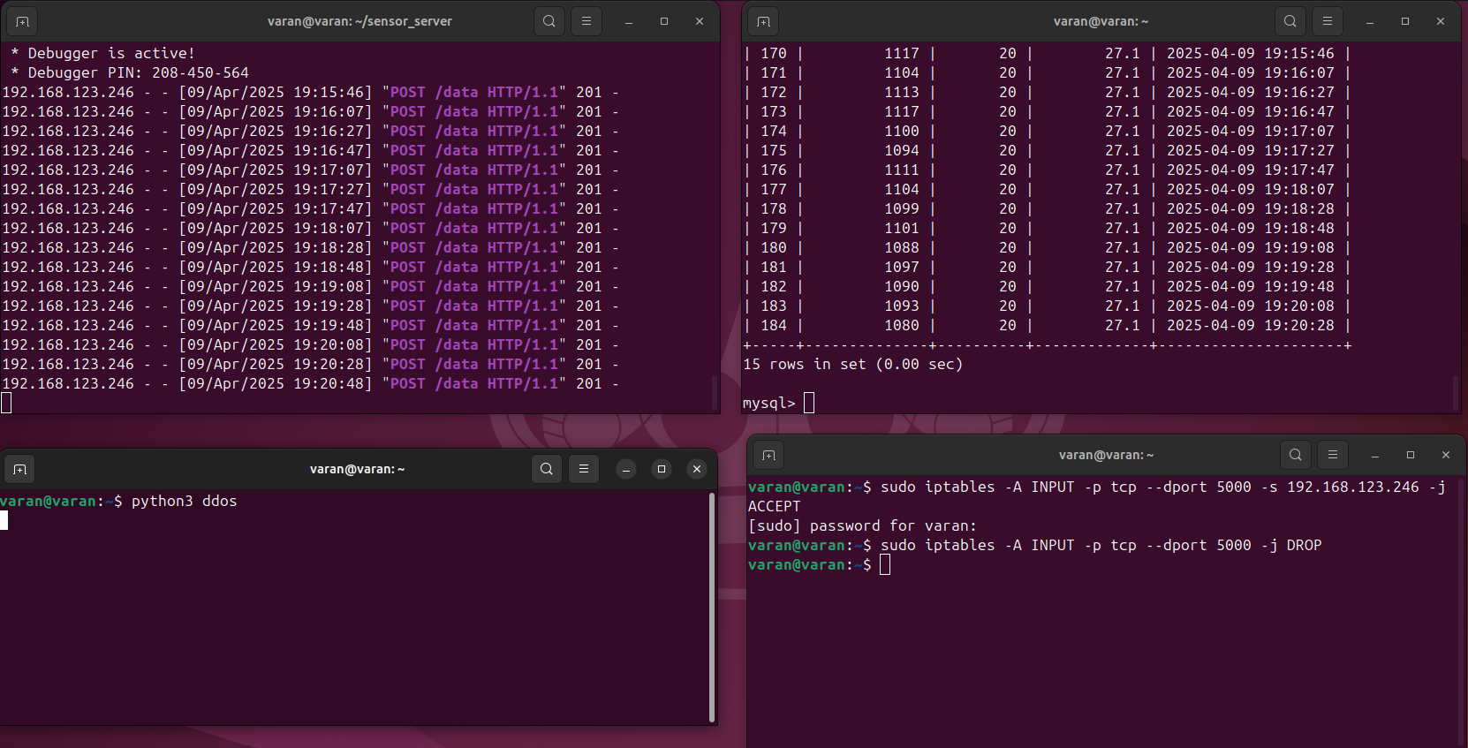
attack & defense – scenario 1
In scenario 1 : the Firewall Rules (iptables/ UFW) was used
Defense : Blocking suspicious or unknow IP addresses

Slide 14
attack & defense – scenario 2
simulate a Data Spoofing & implement a defense mechanism.
Data Spoofing is when an attacker send incorrect data to the server , (e.g.in this case sending incorrect temperature or gas values after modifying it {"gas": 450} → {"gas": 0} // Fake "safe" reading)
and this causing :
Trigger false alarms.
Hide critical events (e.g., gas values leaks).
Corrupts database entries, misleads Node-RED dashboards, and compromises safety.
Manipulate analytics.

Slide 15
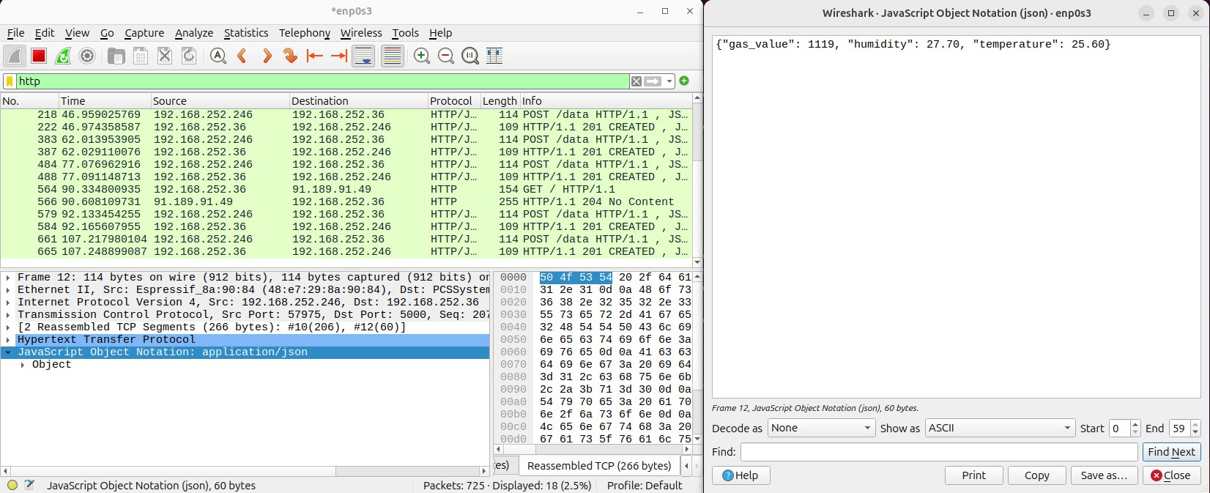
attack & defense – scenario 2
Capture the packet which sent from the ESP32 to the server by using Wireshark and knowing the format of the data.

Slide 16
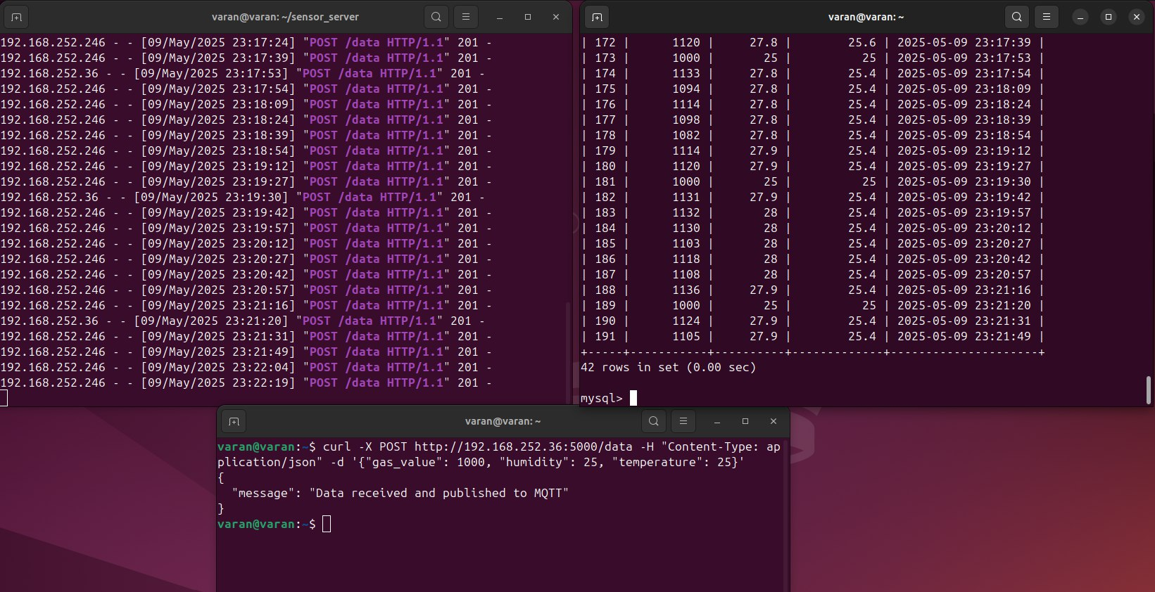
attack & defense – scenario 2
sending incorrect temperature & gas values to the server with same format of the correct packet

Slide 17
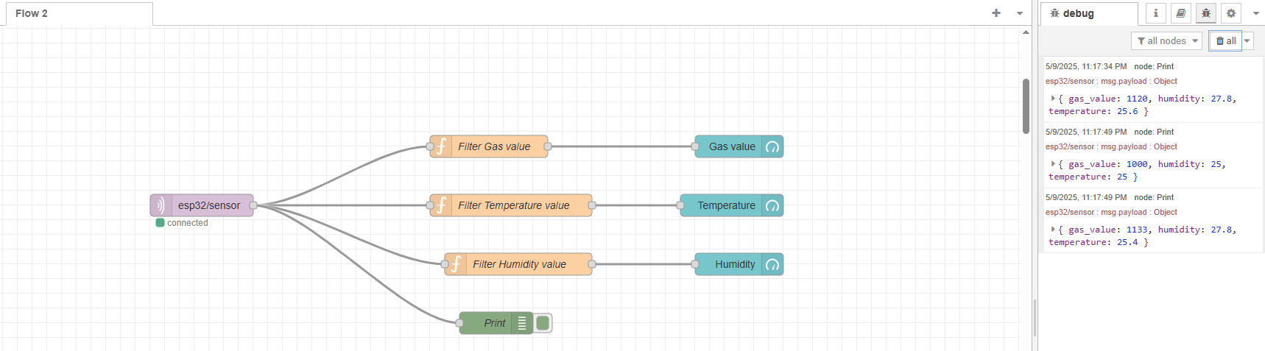
attack & defense – scenario 2
The server receives the incorrect data and then sends it to the Node-Red

Slide 18
attack & defense – scenario 2
There are two available options :
1- HMAC-SHA256 (Hash-based Message Authentication Code using SHA-256)
is a cryptographic mechanism that combines a secret key with a message and applies the SHA-256 hashing algorithm to produce a fixed-size output.
It provides both data integrity and authentication by ensuring that the message was generated by someone who knows the shared secret key.
2- Firewall Rules (iptables/UFW):
Blocks suspicious IP addresses
Filters malicious traffic patterns

Slide 19
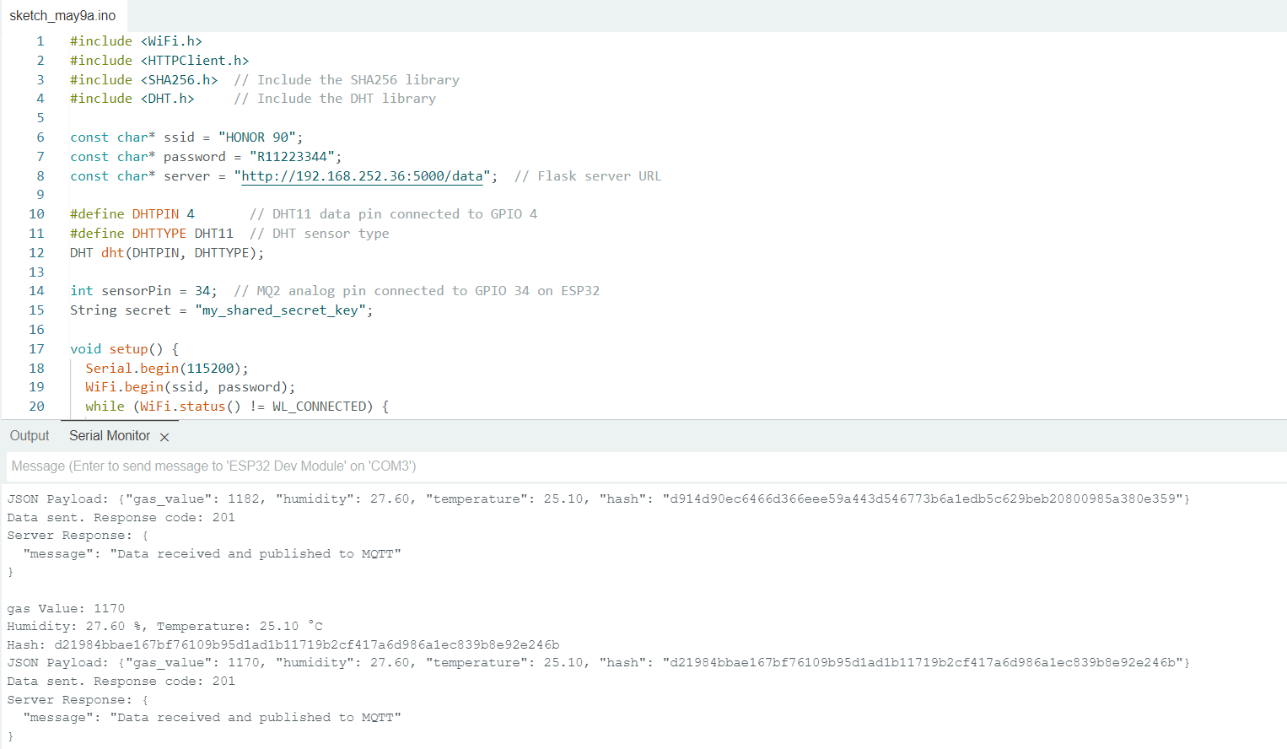
attack & defense – scenario 2
In scenario 2 : HMAC-SHA256 was used
ESP32: Sends a JSON payload that includes Data + Hash computed as SHA256(“Gas value, Humidity, Temperature" + secret key)
so, the ESP32 computes a SHA256 hash of the data string concatenated with a secret key and then sending it to the server.

Slide 20
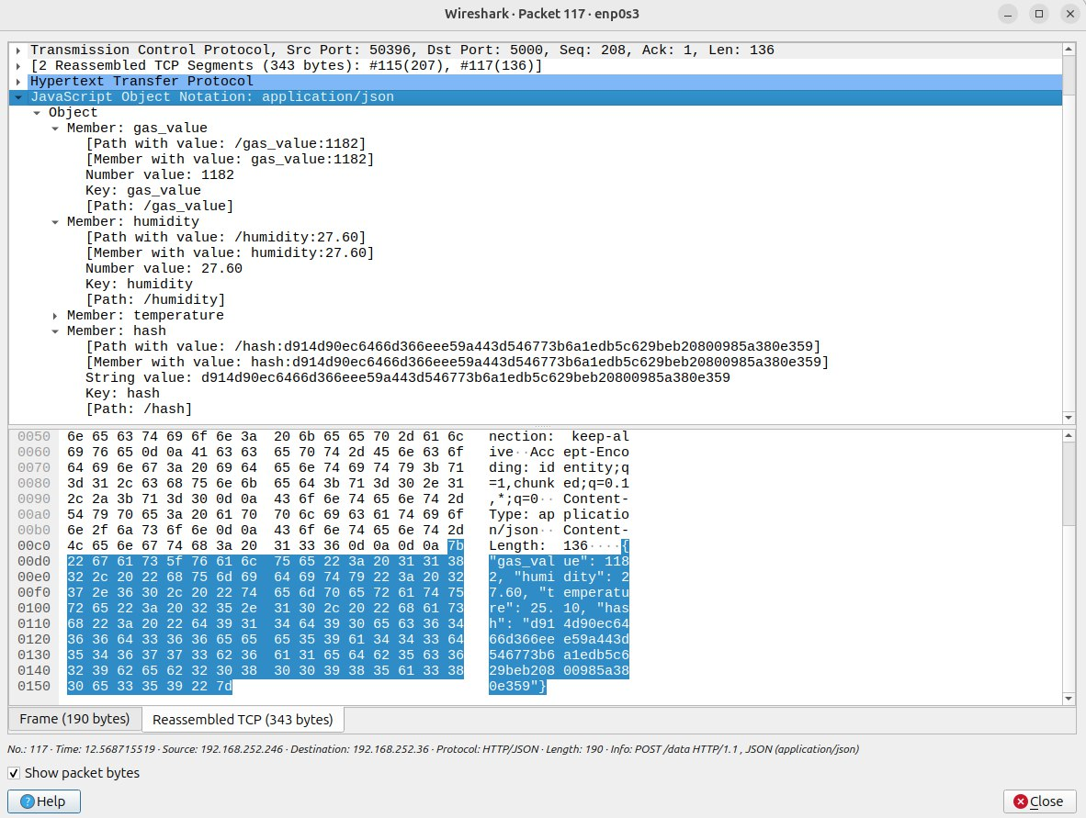
attack & defense – scenario 2
In Wireshark , after capture the payload:
even if the hash and the data are visible (because it is not encrypted), and the attackers try to send incorrect values, they can't compute a valid hash ( without knowing the secret key), and the server will reject the request.
This is a lightweight and effective way to authenticate data from ESP32 to the server.

Slide 21
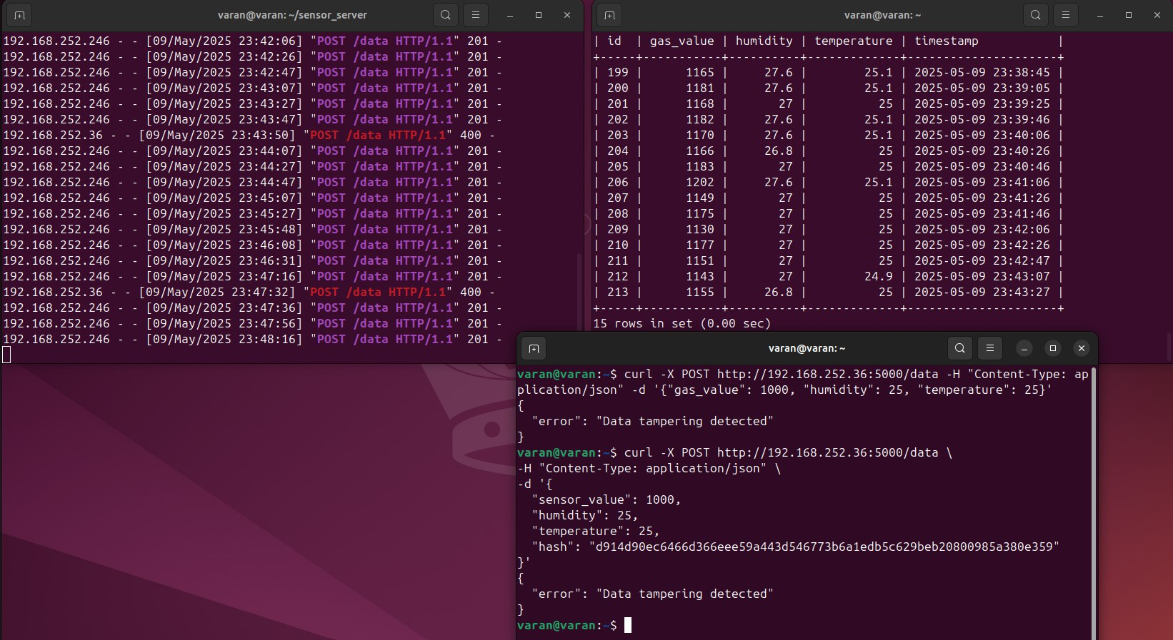
attack & defense – scenario 2
Server :
will extract the JSON payload and recompute the hash from data + secret in the same way.
verify the hash sent by the ESP32 by comparing it with its own locally computed hash.
If they match → data is accepted, and then send it to the Node-Red.

Slide 22
attack & defense – scenario 2
So, using HMAC-SHA256 provides :
1- Integrity : The hash ensures that the data hasn't been modified in transit. If even a single bit changes in Gas value, humidity, or temperature, the hash won't match.
2 – Authenticity : By including a secret key in the hash that only the ESP32 and server know, it proves that the data came from a trusted source (the ESP32).An attacker who doesn't know the secret can't forge a valid hash even if they know the data format.

Slide 23
Conclusion
This project demonstrates a secure IoT sensor data monitoring system.
It defends against Data Spoofing using HMAC-SHA256 to ensure data integrity and authenticity, while firewall rules defend against DoS attacks.
A Flask server verifies hashes using a shared secret.
Real-time monitoring is achieved through MQTT and Node-RED
This architecture showcases a practical and effective approach to IoT security.

Slide 24
Thank you very much

